Slide 1
A/B TEST ANALYSIS
GloBox Food and Drink Banner Experiment
Presentation by: Rutuja Kale

Slide 2



Context
Goal:
the company wants to bring awareness of food and drink product category to increase revenue.
Parameters:
conversion Rate
Average Amount Spent
Project Date:
25th Jan-2nd Feb 2023 (13Days)
Group A: Control
Group B: Treatment
View existing landing page
View landing page with Food and Drink Banner

Slide 3
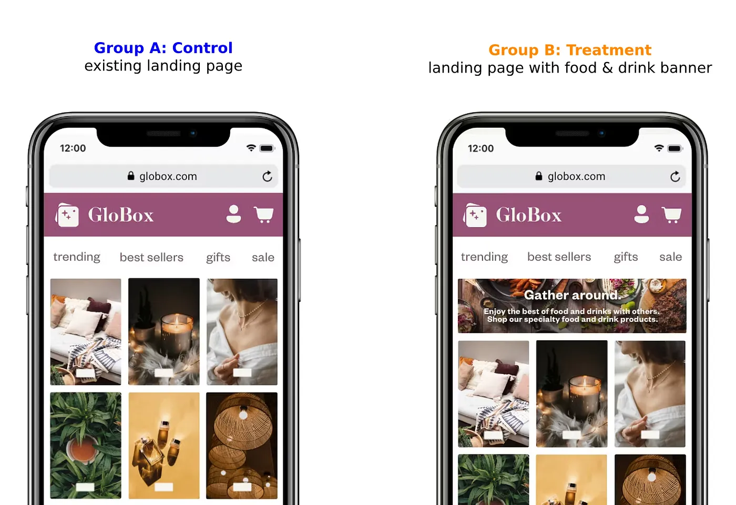
RESULT
Users: 24343
Conversion Rate:3.92%
Average Amount Spent:$3.37
Users: 24600
Conversion Rate: 4.63%
Average Amount Spent:$3.39

Slide 4
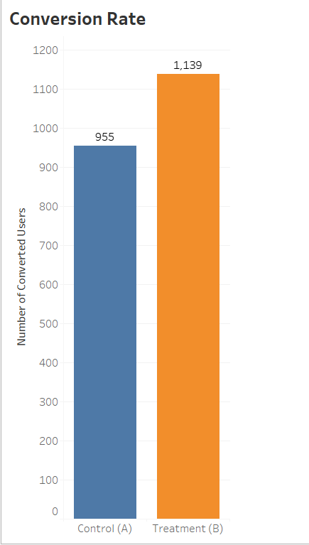
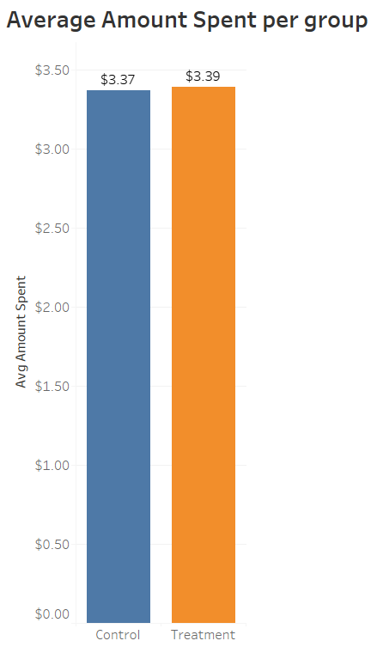
PARAMETERS
It is found that there is a difference in Conversion rate with range between 0.35% and 1.07%
There is NO difference in Average Amount Spent between the groups

Slide 5
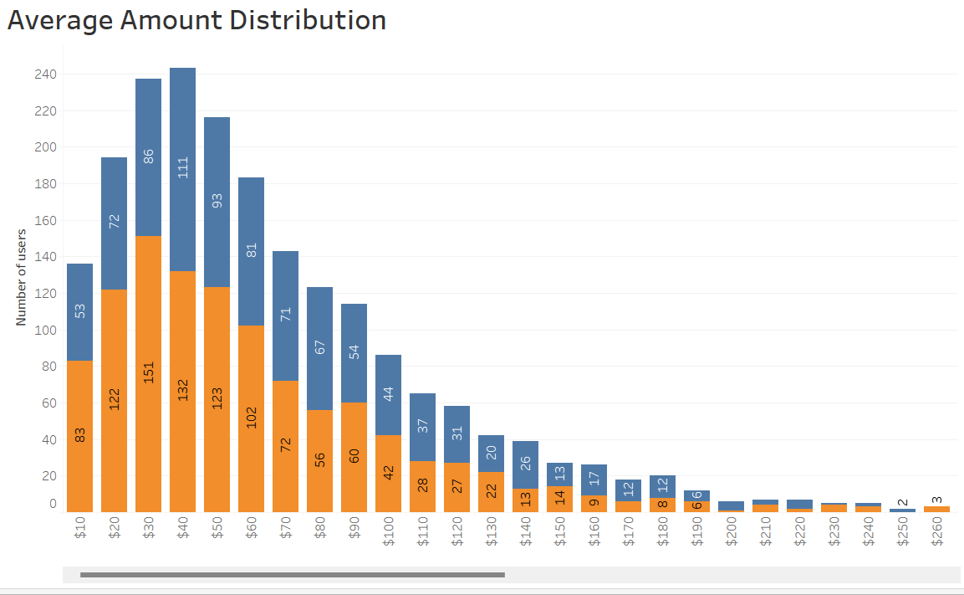

AMOUNT SPENT DISTRIBUTION
Majority of Control Group spent between $40-$50.
Majority of Treatment Group spent between $30-$40.

Slide 6

INSIGHTS
Gender-wise: Males from the Treatment Group had notable 44% increase in conversion rate
Device-wise: 10.6% increase in conversion rate for iOS users and 27% uplift for Android users
Location-wise :Europe shows 32% improvement in conversion rate , South America shows 22% while Asia

Slide 7
RECOMMENDATION
Based on the results above , It makes sense to launch the treatment so I would recommend that we do launch it.
Reasons:
Banner positively impacts conversions
Implementation is feasible and resource-intensive
Actionble Steps:
Closely monitor performance and track key metrics for success.
Analyse user preferences and behaviour within the Food and Drink category.

Slide 8
THANK YOU
Presentation by : Rutuja Kale

